Slide 1
People with aphasia told us that the title should tell them what they will learn from watching the video (ARC survey, 2020). They prefer the author’s credentials and photos at the end of the video.

Slide 2


Type of research:
Qualitative
(Getting people’s views)
Experiment
(Trying something out)
Review
(What is already researched?)
Delete irrelevant research types, leaving the correct one ↑

Slide 3
Study design quality:
Quantitative research: Circle the level as per Oxford CEBM levels of evidence II

Slide 4


12
Number of participants:
More than 6 months
0-3 months
10 years
Participants had aphasia for
Delete/change as needed
Go to https://www.pdclipart.org/thumbnails.php?album=41 for flag icons
Participants were from:
Australia
United Kingdom

Slide 5
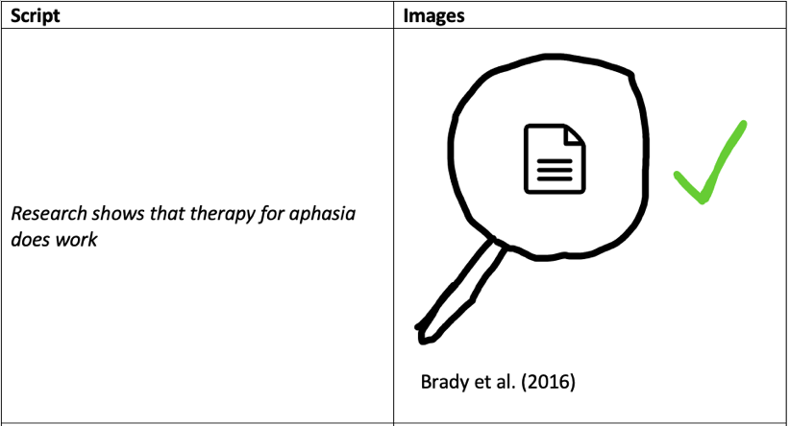


Your storyboard tells you what graphics will go on each slide
Script goes into the caption space – approx. one sentence or phrase per slide
captions/script
You may need to change the height of this box but don’t shrink the text size.

Slide 6
If you are recording a ‘talking head’ make sure you leave a space on each slide for the video element. You don’t want your text or graphics covered up by your video.
(Brady et al., 2016)
Captions/script will go in this space

Slide 7
Repeated title and authors, logos

